Slide 1
Link to the webpage
The sole purpose of an enterprise is to satisfy people’s
material and immaterial needs.
The 8th view is for managers.
The greatest Enemies of good and proper Management are
Systemic Errors in the Fundamentals of Classical Economic Theories.
Their Blind Spots in mapping intangible resources (potentials),
their Outdated Linear (monetary) Value Metrics (paradigm), KPIs and misleading landmarks are making it impossible to design
and realize a sustainable social and economic system.

Slide 2
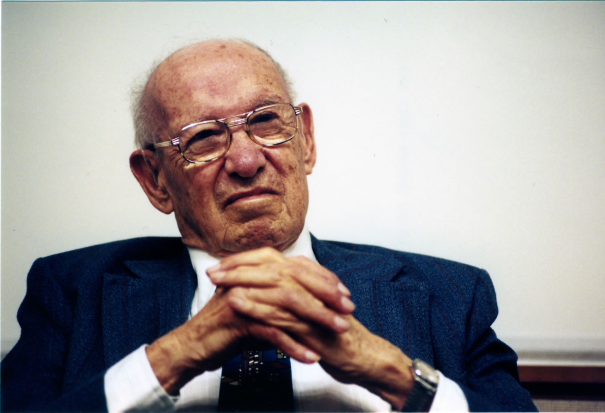
Management is core, but....
“We also need to develop a (new) economic theory…. “
“We also need to develop an economic theory appropriate to a world economy in which knowledge has become the key economic resource and the dominant... source of comparative advantage.”
Peter E. Drucker, The Atlantic 11/1994
in: The Age of Social Transformation
https://www.theatlantic.com/past/docs/issues/95dec/chilearn/drucker.htm
Link not working? Go to WebArchive of original ‘The Atlantic’. Click here.

Slide 3
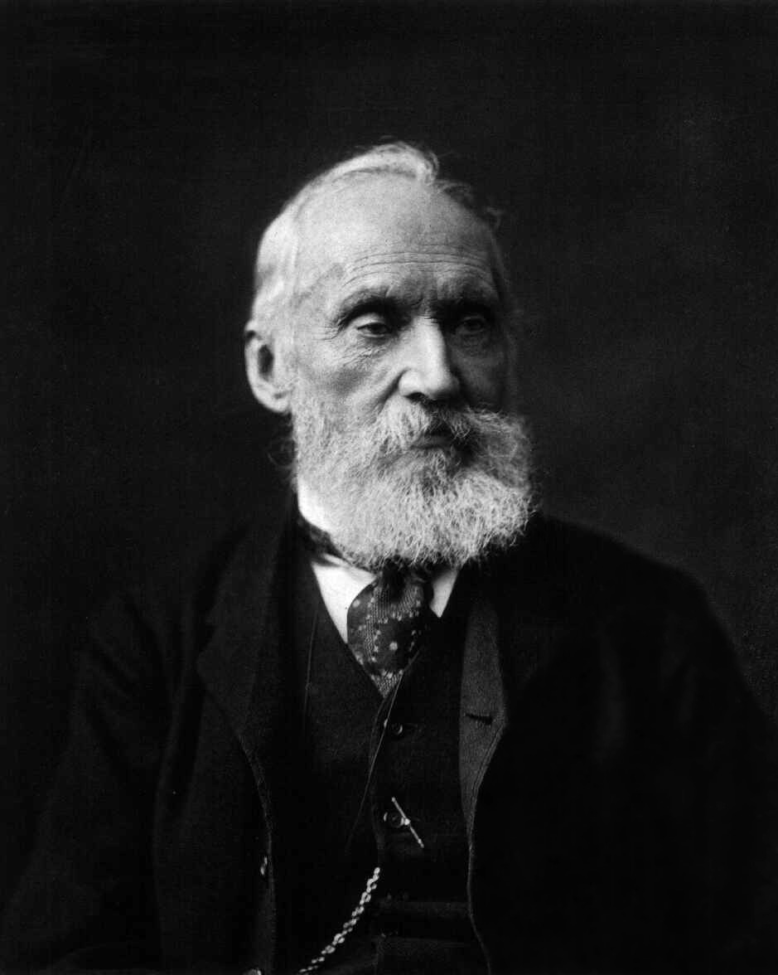
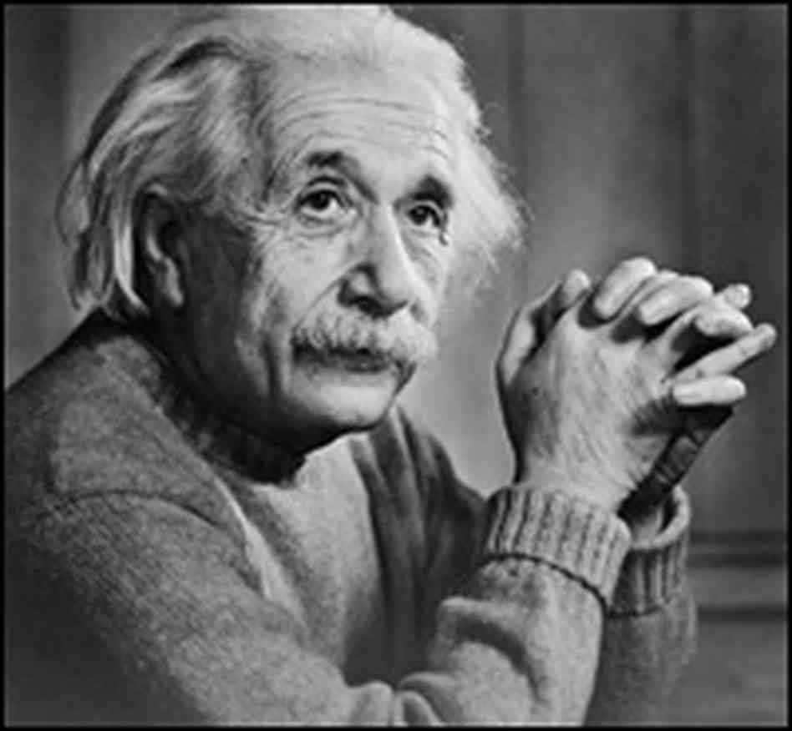
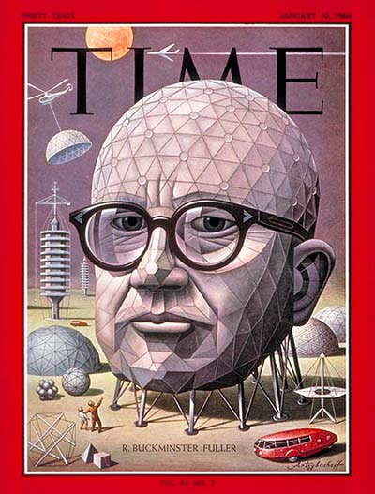
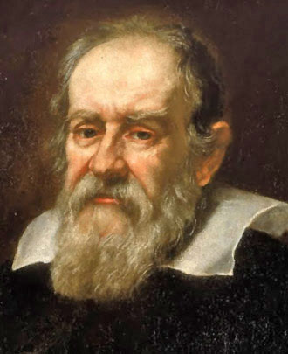
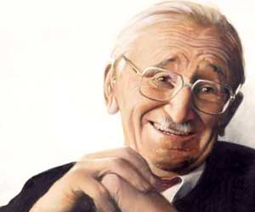
Basic thoughts about theories
"I often say that when you can measure what you are speaking about and express it in numbers you know something about it;
but when you cannot measure it, when you cannot express it in numbers, your knowledge is of a meager and unsatisfactory kind:
it may be the beginning of knowledge, but you have scarcely, in your thoughts, advanced to the stage of science, whatever the matter may be.“
Lord Kelvin, Electrical Units of Measurement, 1883
“You never change things by fighting the existing reality.
To change something, build a new model that makes the existing model obsolete.”
R. Buckminster Fuller
“It is the theory which determines what we can observe.”
Albert Einstein
“Count what is countable,
measure what is measurable,
and what is not measurable,
make measurable.”
Leonardo da Vinci
“Many of the patterns of nature we can discover only after they have been constructed by our mind.”
Friedrich von Hayek

Slide 4
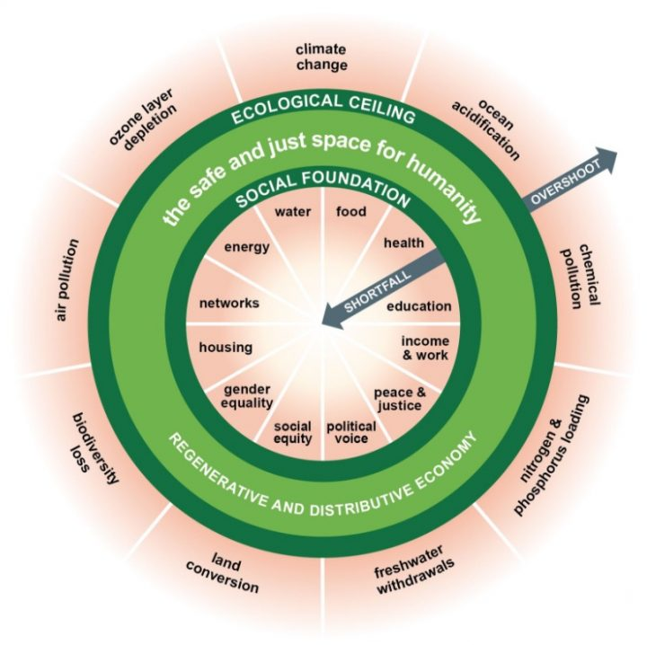

What matters in decision making
Next Generation Management Models
Management
Work your plan
Decision making
Plan your work
Applied economics
Basic economics
Next Generation Economic Models

Slide 5


Grundlagen der
zukünftigen Existenz
Entwicklungsverläufe wichtiger Systemaspekte
Grundlagen der
gegenwärtigen Existenz
Vergangenheit
Heute
Zukunft
Zeit
© malik 2015
http://malik-management.com/en
Management Innovation
Enhanced Economic Paradigms

Slide 6
Management Innovation
https://malik-management.com/
© malik 2015
Enhanced Economic Paradigms

Slide 7
Management Innovation
https://malik-management.com
© malik 2015
Enhanced Economic Paradigms
(+ Intangibles
+ vector value metrics)

Slide 8
Legal und paralegal factors, lobbies (enabler, inhibitors)
At least 83% of formal determined (legal & paralegal) and used rules complicate and hinder right and good management.
It's about to gradually redesign the most important rules from scratch
to the requirements for the design of intelligent organizations and societies.

Slide 9
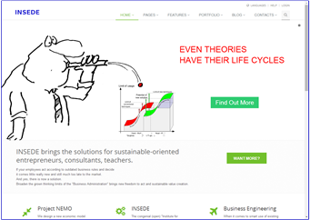

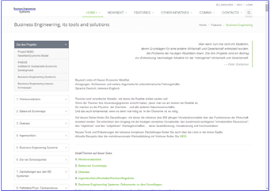


Three smart steps for clever real world solutions.
Combining Tangible and Intangible Assets and Wealth, incl. Intellectual Capital and Integral Value Metric
Project NEMO
The project that realizes the «New/Next Economic Model»
Project NEMO The project that realizes the «New/Next Economic Model»
INSEDE
Clever solutions for the smart real world
Business Engineering Systems
Modular, new options beyond old systemic traps
Project Nemo (New/Next Economic Model)
http://project-nemo.org
INSEDE (Institute for Sustainable Economic Development)
https://insede.org
Business Engineering Systems (Tools for decisioners in a smart economy)
https://bengin.net/bes/

Slide 10
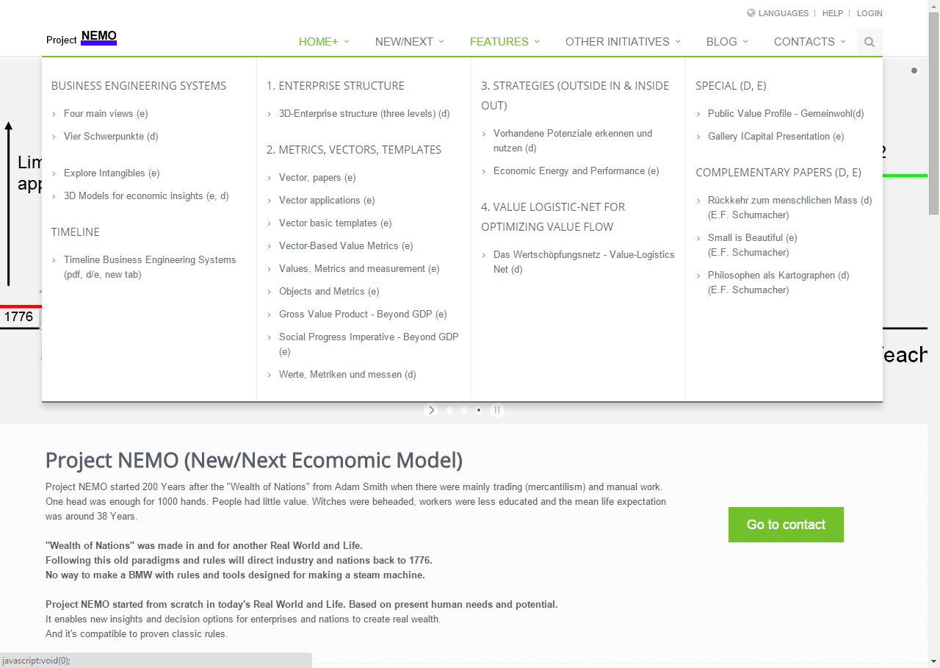
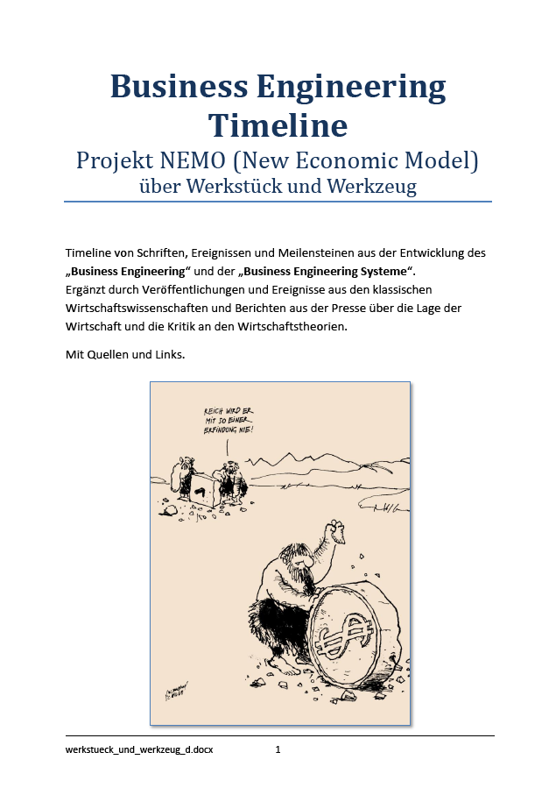
Where to find essentials
Website: http://project-nemo.org

Slide 11
Timeline of Business Engineering Systems©
(with links to original papers)
Web:
http://project-nemo.org
https://insede.org
https://bengin.net
https://bengin.net/bes/
https://twitter.com/peterbretscher
https://www.linkedin.com/in/peterbretscher
https://www.facebook.com/peter.bretscher
https://www.youtube.com/peterbretscher
(https://google.com/+PeterBretscher)
INSEDE (Institute for Sustainable Economic Development)
Ingenieurbüro für Wirtschaftsentwicklung
Peter Bretscher, Dipl. Ing.
Alpsteinstrasse 4
CH 9034 Eggersriet (Switzerland)
Mobile: +41 79 650 49 04
peter.bretscher@bengin.com
peter.bretscher@insede.org

Slide 12
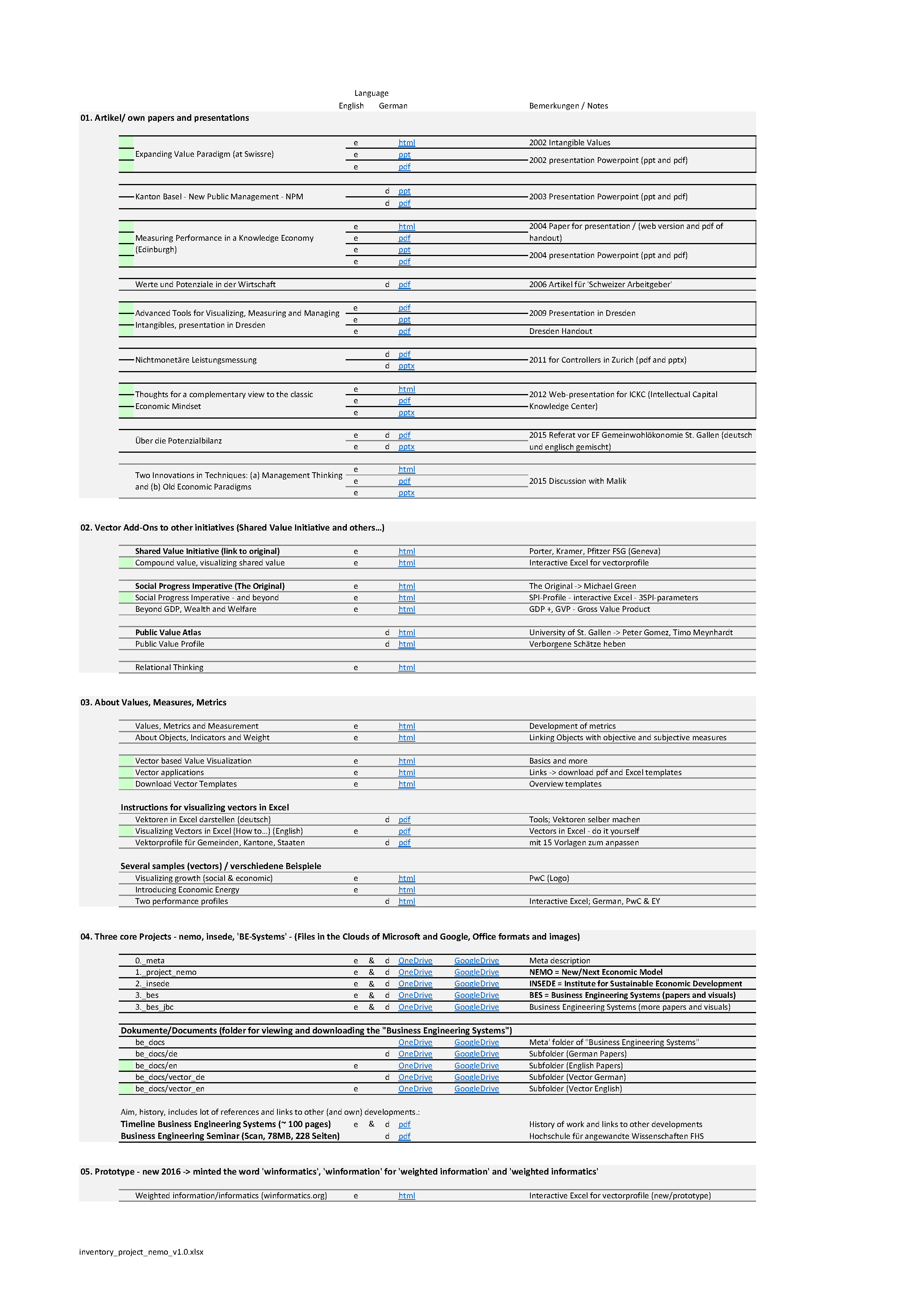


PDF with some further links to “Business Engineering Systems”
https://bengin.net/doughnut/dl/inventory_project_nemo_v1.0.pdf
More about why to redesign economic MindWare.
https://www.kateraworth.com/
https://marianamazzucato.com/
insede (Institute for Sustainable Economic Development) – open.institute
insede is part of Project-NEMO (New/Next Economic Model)
© 2015, rev. 2019 peter.bretscher@insede.org

