Slide 1
Integral
Transparency in Economics
The Imperative
INSEDE

Slide 2
Management Summary
Fundamental change in economic understanding – huge economic opportunities for professional early adapters [in economic education (base and advanced), bookkeepers, consultants, lawyer, chartered accountants]
Ready to apply
New hybrid value generation model that takes into account tangible and intangible assets as well as monetary and non-monetary valuation metrics.
Solution that respects intellectual property rights – and that sets its own claims.
Good for individual and proprietary solutions.
Several years beyond crowd.

Slide 3
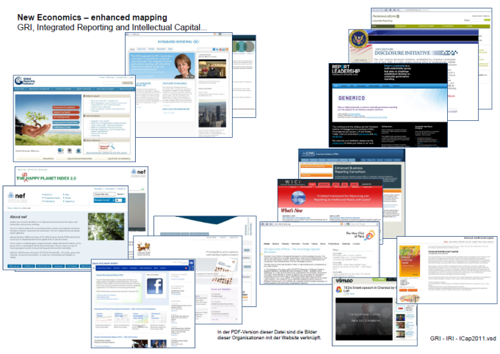
Actual situation / challenges
Growing awareness that theory no longer fits reality
Strong efforts from individuals to Governments, from:
HRH Prince of Wales (Integrated Reporting) to David Phillips (PWC UK)
to Soros (ineteconomics) to SEC (Disclosure Initiative) to GRI to EU…..
Other forerunners in economic mindsetting:
Click at picture right opens PDF with respective links.
Problem they face:
Thinking outside of their cage and
develop transdisciplinary models and tools.

Slide 4
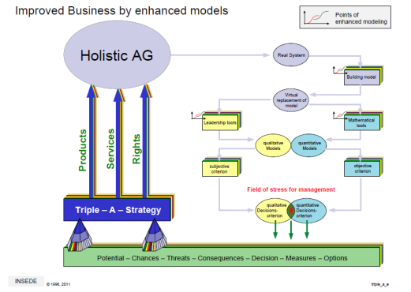
Benefits for clients
lower tax
Enhanced transparency
Integral valuation
new strategic options
new products
new jobs, growth
(tangible & intangible; monetary & nonmonetary)
new solutions in business improvement
Risks and opportunities are more transparent
Decisions are based on real facts & figures
Triple A strategy
Additional holistic views/maps
Mastering complexity

Slide 5
Benefits for Ernst & Young
Potential [i$]
Implicit
Intangible
Knowledge
Reputation
30
25
[$]

Slide 7
beconomic
Ernst & Young
Project started 2000
Project ended 2001
2011 still years ahead of the crowd

Slide 8
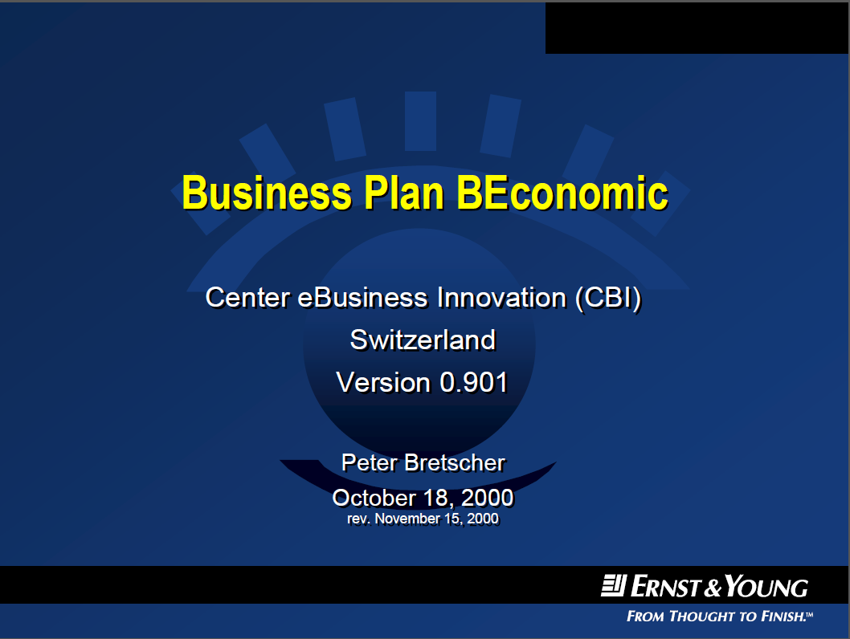
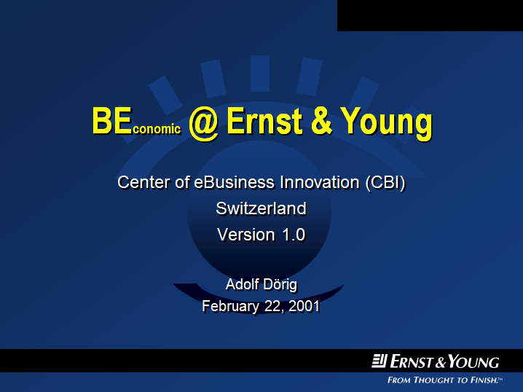
Beyond classic Advisors’ Focus
Link for download ppt
Link for download ppt

Slide 9
Track 2001 to 2011
Invest: CHF 4 Mio.
Intangible assets
Nonmonetary KPI’s
Subjective valuations
Technology
Visualizing data

Slide 10
From obstacles to insights to solutions
Here they are
Here we go (they’ll come later)
Here we are

Slide 11
What Transformation?

Slide 12
Influencer to Transform
CxO

Slide 13
Clarity – Transparency – Security

Slide 14
Next steps
Professional legal base
To do’s:
Basically the same as proposed 2001 to E&Y
(see Business Plan Project BEconomic)
Enhanced by other professionals from other service organizations.
Already on track.

Slide 15
INSEDE options for Ernst & Young
...shape economic future as....
Application Partner
Development Partner
Investment Partner

Slide 16
INSEDE
Institute for
Sustainable Economic Development
© 2011 www.insede.org

Slide 17
Rösel

Slide 18
Benefits for Ernst & Young
Overall
  Reduced liability.. Transparent valuation.. audit..
  Proprietary solutions (payback wit licensing out).. Mastermind..
Long term:
  Top line + 100% over 5 years
  Bottom line +
Mid term:
Short term:

Slide 19
Ernst & Young
Audit
  45%
Tax / Legal
  20%
Corporate Finance
  15%
Advisory / Consulting
  20%

Slide 20
Benefits for
Ernst & Young

