Slide 1
Transparence in Economics
The imperative

Slide 2
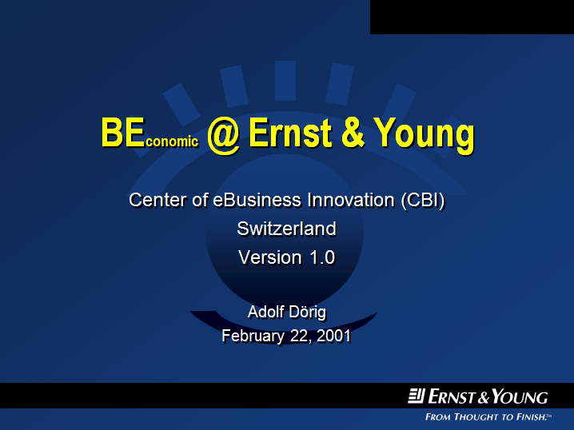
Beyond Advisors’ Focus

Slide 3
2001 - 2011
Invest: CHF 4 Mio.
Intangible assets
Nonmonetary KPI’s
Subjective valuations
Technology
Visualizing data

Slide 4
Transformation of Tools
Here we are
Here we go

Slide 5
What Transformation?

Slide 6
Influencer to Transform
CxO

Slide 7
Sustainable Transformation

Slide 8
benefit

Slide 9
INSEDE options
Application Partner
Development Partner
Investment Partner

Slide 10
INSEDE
Institute for
Sustainable Economic Development
© 2011 www.insede.org

