Slide 1


Measuring Performance in A Knowledge Economy:
Linking Subjective and Objective Measurement into a Vector-Based Approach for Performance Measurement
Juergen H. Daum, Chief Solution Architect, SAP AG, Walldorf, Germany
Peter Bretscher, Ing. Büro für Wirtschaftsentwicklung, Eggersriet, Switzerland
Presentation prepared for the PMA Conference 2004 (“The 4th International Conference on Theory and Practice in Performance Measurement and Management”) , 28-30 July 2004 in Edinburgh, UK

Slide 2
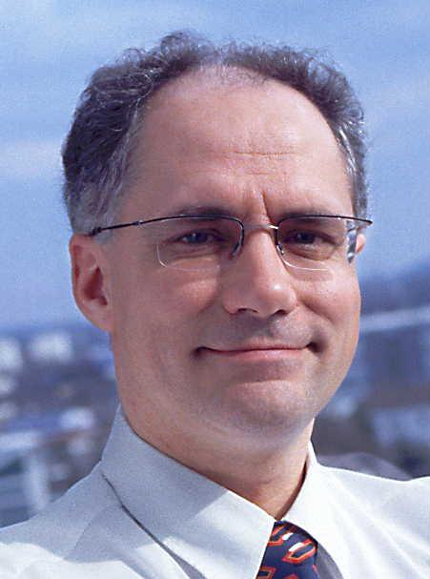
The Speakers
Juergen H. Daum,
Chief Solution Architect,
Business Solutions Architects Group, SAP AG, Walldorf / D
Function in the Business Solution Architects Group:
CFO Relationships, advisory role in „Finance Transformation“ and „Enterprise Performance Management“ projects
Finance and management background (was a CFO in a mid-sized German company before joining SAP in 1992)
Spend five years in SAP’s field organization in Germany and Europe (sales, consulting, product management) with the focus on financials and enterprise management
6 years in development: first as product manager for R/3 Enterprise Controlling and Strategic Enterprise Management (SEM), then as program manager for mySAP Financials
Since begin of 2002: advising senior executives, CFOs, corporate controllers - with a current focus on finance transformation + enterprise performance management
He is frequently publishing and speaking about enterprise performance management, finance and other management topics and he is the author of the book "Intangible Assets and Value Creation“ (Wiley 2002). E-Mail: juergen.daum@sap.com, Website: http://www.juergendaum.com/

Slide 3

The Speakers
Peter Bretscher,
Founder and owner,
Ing. Büro für Wirtschaftsentwicklung, Eggersriet / CH
Function in the Ing.Büro: Advisor to organizstions in the design of economic steering and management systems that integrate the intangible perspective
Engineering background (worked 20 years in several functions along the whole value chain of an international R&D and manufacturing company based in Switzerland)
Developed over the last 15 years management concepts and methods that integrate the intangible perspective
In addition he is supporting companies, consultants, and other organizations in innovation and project management, in intellectual property and patent management, and in setting up business plans and defining enterprise strategy
He has initiated and is leading the “bengin” project. Its mission is to facilitate the awareness for and further development of management concepts that enhance the traditional economic model
Since 1994 he is teaching business engineering und business planning at the Hochschule für Wirtschaft, Technik und soziale Arbeit in St. Gallen, Switzerland.
E-Mail: peter.bretscher@bengin.com, Website: https://bengin.net/bes/ and https://insede.org

Slide 4

Agenda
Implications of the knowledge economy for performance measurement and management: subjective measurement - why and how?
The concept of Vector-Based Performance Measurement & Visualisation
Practical application cases of the concept
Conclusion & outlook

Slide 5


Implications of the knowledge economy for performance measurement and management
Focus on
internal Efficiency
Focus on
external Effectiveness
Seller‘s Market
(until the 1970s)
Buyers‘s Market
(since the 1970s)
industrial economy
(car production in the 1920s)
knowledge economy
(media production in the 2000s)
subjective
values/effects
Customer focus:
● availability  (absolute) price
Customer focus:
● variety  subjective customer value
Managerial focus:
● production capacity  cost
Managerial focus:
● innovation  customer realations
investments
in intangibles

Slide 6
The consequence:
The transformation of the asset basis of corporations
62%
38%
18%
Tangible
Assets
82%
Intangible
Assets
Market
Value
62%
38%
1982
1992
2002
Average for Standard&Poors500 Companies
Energy + Industrial Assets
Machinery & equipment
Physical Infrastructure
Inventory
Knowledge + Intangible Assets
Human + Intellectual Capital
Innovation power / R&D pipeline
Brands and Relationships
Efficient Production
Intelligent Enterprise
Notes:
Efficient production drives productivity gains in the industrial economy
Balance sheet is tailored to industrial economy: PPE (plant property and equipment) uses the abundance of energy to transform raw material into sellable products
Output is limited by physical capital (to use abundance of energy)
Intelligent business decisions are drivers of the information centric economy
Today, effectiveness is limited by human capital shortage to transform abundance of information into insights and competitive advantage (information processing tools and solutions alleviate the shortage)
Balance reflects does not reflect information assets but there are real
Examples (Information Assets):
Coca Cola
Statefarm Insurance, Pratt & Whitney
Southwest Airlines
Dell Computer

Slide 7
What are Intangible Assets?
Intangible Assets are immaterial and non-financial resources
(not physical or investment), which are of value
to the company and its investors
Enterprise-
Ressources
Financial
Assets
Physical
Assets
Intangible
Assets
Relationship
Assets
Structural/Org.-
Assets
Human
Assets
Customer capital:
brands, customer relations
Partner capital:
supplier network,
dealer network
Business infrastructure:
work procedures, processes, information systems etc.
Products / R&D capital
Intellectual property:
patents, copyrights, etc.
Individual know-how, professional and social competence, innovation & adaption capabilities,
- of employees and freelanccers

Slide 8
The challenge: value created is not a function of the amount of money that has been invested
Input
R&D expenditures
R&D
Cust. Value: Products that meet subjective customer values
Fin. Output: Revenues, Market Share & Profits
Output in form of profit and shareholder value growth is not a direct function of financial input. Instead, output depends on the capability of the firm to create a positive effect from a subjective customer perspective (to create subjective customer value with new products)
Organisations need performance measurement systems that are able to handle subjective, qualitative measures and to combine them with quantitative, financial information

Slide 9
“Measurement”
of subjective values –
sounds unusual?

Slide 10



We are using subjective “measurement” all the time
Example 1: Temperature
(ask Alfredo and Lars what they regard as “normal” temperature)
“subjective
temperature impression/
rating”
“hot”
“normal”
Alfredo
(South
Italian)
Lars
(Nordic)
subjective
rating of “hot”
“cold”
subjective
rating of “cold”
-20°
0°
20°
40°
“normal”
temperature
“objective temperature”

Slide 11



We are using subjective “measurement” all the time
Example 2: Price
(How much is Mrs. Miller willing to pay for her new dress?)
“subjective”
customer
value
“expensive”
“normal”
Dress from
Designer
Boutique
subjective
rating of “expensive”
Dress from
Dep. Store
“cheap”
subjective
rating of “cheap”
“normal”
price
100
350
700
900
price

Slide 12
We are using subjective “measurement” all the time
Mrs. Miller’s product valuation
Dress from Boutique
Brand /
Designer Label
at this price Mrs. Miller would buy
Design
Dress from Dep. Store
Intangible
Values !
Design
Shop experience
Shop experience
Material
Material

Slide 13
“Measurement” of subjective values – sounds unusual?
Every customer is placing a (intangible) value on products or services according to subjective qualitative criteria.
Organizations that provide services or products to customer have to consider this subjective, qualitative (intangible) dimension in managerial decision making throughout the entire value chain.
Otherwise they would not be able to use their full potential to create value (for customers, shareholders and other stakeholders)
Organisations need performance measurement systems that value subjective, qualitative value through relative ratings
and that combine them with quantitative, financial information

Slide 14
“Measurement” of subjective values – sounds unusual?
Consider the Credit Rating Services of S&P:
An example for of a qualitative measurement system is the rating of a company’s credit worthiness by Standard & Poor's (S&P) with ratings ranging from “AAA” to “D”. While S&P has probably internal rules and standard procedures governing how they rate a company, the rating results are nevertheless “subjective”: they are based on a S&P's -specific valuation/measurement system and on personal qualitative expert-judgments by the analysts in charge. Because no objective measurement scale for the credit worthiness of a company exists (at least not yet), the S&P rating cannot be compared directly with the ranking of e.g. another rating agency or with the rating of a company's housebank. Nevertheless, the S&P rating is widely accepted and provides useful information about a company for capital market participants or suppliers.
Measurement of subjective values: based e.g. on expert rating or by using relative measure scales (such as a 1-5 point system)

Slide 15
Agenda
Implications of the knowledge economy for performance measurement and management: subjective measurement - why and how?
The concept of Vector-Based Performance Measurement & Visualisation
Practical application cases of the concept
Conclusion & outlook

Slide 16
The concept of Vector-Based Performance Measurement & Visualisation
The Basics of the Concept
qualitative
valuation
(e.g.. subjective
customer value / customer satisfaction)
➔ organisational effectiveness in satisfying customer
demand and meeting
customer expectations
α= sustainabiliy indicator
qualitative / subjective
decreased
effiectiveness
Total (Compound) Performance
quantitative / financial
α1
increased
efficiency
α2
monetary/quantitative valuation (e.g. cost, profit)
➔ organisational efficiency in utilizing ressources

Slide 17
The concept of Vector-Based Performance Measurement & Visualisation
Vector Aggregation and Drilldown Analysis
(Example: Automotive R&D)
subjective
customer value (of the product)
➔ R&D effectiveness
qualitative / subjective
Functionality
Brand / Image
Total (Compound) Performance
Body /
Design
quantitative / financial
Drill-Down
Chassis
Engine
R&D expenditures / input ressources
➔ R&D efficiency

Slide 18
The concept of Vector-Based Performance Measurement & Visualisation
Benefits of the Concept:
Helps managers to keep taps on all relevant aspects
(subjective and objective) of the decision making process
Makes subjective and objective views comparable and communicable – independent of time and location (= increased transparency across the entire organisation)
Due to its mathematical foundation, aggregations and de-aggregations are easily possible (linking the strategic overview with the operational view)
Represents an efficient and effective management information management concept / it is easy to understand from a managerial perspective
Assumptions behind the decisions and the history of the decision making process become transparent

Slide 19
Agenda
Implications of the knowledge economy for performance measurement and management: subjective measurement - why and how?
The concept of Vector-Based Performance Measurement & Visualisation
Practical application cases of the concept
Conclusion & outlook

Slide 20
Application at
Public Service Organisations

Slide 21
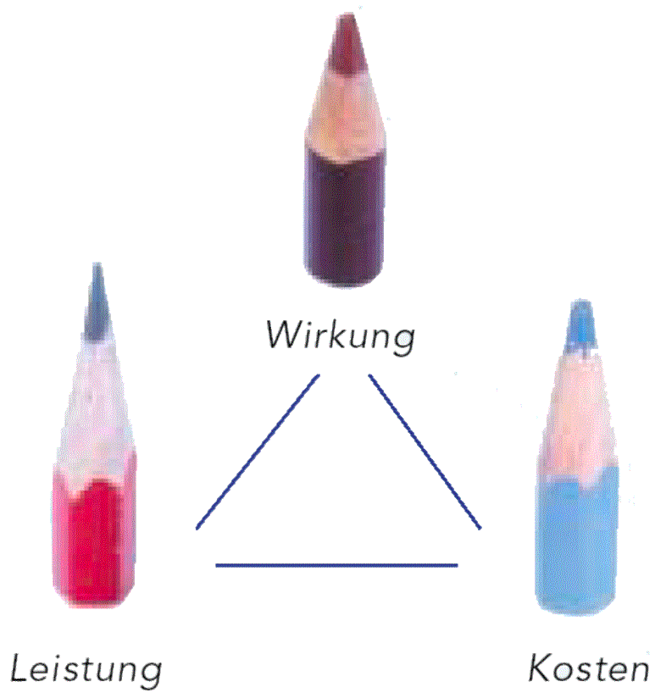
Application at Public Service Organisations
„New Public Management“ of the Kanton Basel-Stadt/CH
Effects
Performance
Costs/Budget
„New Public Management“ (NPM)
– effect-oriented public service management:
How should our politics affect the citizens? (effects)
What contribution/performance of the public service administration is required to achieve these effects? (activities and their performance)
How much does it cost? (costs)
The basic assumption is, that optimal results will become possible when effects, activities, and their performance and costs are all taken into account together. If one of these three parameters is changed, the change will affect the entire system of the NPM’s “magic triangle”.
Source: Kanton Basel-Stadt, New Public Management im Kanton Basel-Stadt, 2002

Slide 22



Application at Public Service Organisations
„New Public Management“ of the Kanton Basel-Stadt/CH
- Transformation: The Vector-Based Approach to Performance Measurement -
Vector-based
performance measurement and representation system
effects
for citizens
(weighted
in context)
Effects
performance of public service
Performance
Costs
NPM
Magic Triangle
costs /
financial budget

Slide 23
Application at Public Service Organisations
„New Public Management“ of the Kanton Basel-Stadt/CH
- Transformation: The Vector-Based Approach to Performance Measurement -
Public
Service
Departments
9 Police&Justice
8 Others
7 Healthcare
Performance (of public service departments)
Effects (subjective citizen perspective
6 Economie
5 Education
4 Infrastructure
3 Finance
2 Defense
1 Foreign Affairs
Costs

Slide 24
Application at Public Service Organisations
Benefits for a Kantonalverwaltung in applying the Concept Vector-Based Performance Measurement & Visualisation:
Public service managers do not need to wade through 300-page budget documents (that is for instance the actual number of pages for the Kanton Basel-Stadt budget, including product and product group effect objectives and performance targets: 140 product groups, 1000 measures, 140 budgets). A few graphs/charts are enough to get an overview and to link strategy with operational management.
The focus is set in the first place on value and performance (effects for citizens and performance of the public service) and then on financial budgets (on how to get and spend funds). This is alignsing the whole organization with the intended effect of its activities for society and is enabling management to make better trade-off decisions between tight budgets (efficient use of resources) and benefits (effects) from a citizen perspective.
Budget adjustments (e.g. reduction by 10%) are now based on citizens valuations and not just on internal budget/departmental policies

Slide 25
Application at
Car Manufacturers (OEMs)

Slide 26
Application at Car Manufacturers (OEMs)
Vektor-Based Performance Measurement
- Example: Value Contribution Analysis -
subjective Customer Value
(of the entire offering)
Financial Return
Effect on Total (Compound) Performance
-
-
÷
-
ROI
x
÷
+
+
+
R&D
Marketing / Sales
Functionality
Functionality
Brand / Image
Brand / Image
Operative
Performance
Body /
Design
Body /
Design
subjective customer value
(of the product)
subjective customer value
(of the total bundle / offering)
Chassis
Chassis
Engine
Engine
R&D costs / input ressources
sales price achieved
Source: Daum, J.H.: Intangible Assets und die wertorientierte Steuerung von Netzwerken in der Automobilindustrie-Teil 1,
in: Forschungsbericht des Arbeitskreises „Netzwerksteuerung/Network Value Added in der Automobilindustrie“

Slide 27
Application at Car Manufacturers (OEMs)
Vektor-Based Performance Measurement
- Example: Value Contribution Analysis -
Image / Brand
Financing Services
Total
(Compound)
Performance
subjective customer value
(of the entire offering)
Finanzrendite
Customer Service
-
-
customer value created
(through entire bundle)
Total Performance
÷
-
ROI
x
Quality
÷
+
+
Functionality
Margin / ROI
R&D
Fulfillment
Marketing / Sales
Functionality
Final Check
Financing Services
Brand / Image
Final Assembly
Brand / Image
subject. customer value (of the product)
Painting
Customer
Service
Body/
Design
R&D Performance
Quality (from customer perpective)
Production Performance
sales price achieved
Sales /Mktg. Perfm.
Operative
Performance
Body /
Chassis
Chassis
Exras
Engine
Components
Functionality
Cost / Input Ressources
Cost / Lead Time
Marketing- & Sales Expense
R&D Process-KPIs
Fulfillment Process-KPIs
CRM Process-KPIs
qualitative and financial performance of support processes / of ressources
Performance
of Ressource
Management
Finanicial
Assets
Physical
Assets
Relationship
Assets
Structural/
Org.
Assets
Human
Assets
KPIs of support processes
Source: Daum, J.H.: Intangible Assets und die wertorientierte Steuerung von Netzwerken in der Automobilindustrie-Teil 1,
in: Forschungsbericht des Arbeitskreises „Netzwerksteuerung/Network Value Added in der Automobilindustrie“

Slide 28
Application at
Software Companies

Slide 29
Application at Software Companies
Vektor-Based Performance Measurement
Example: Effectiveness & Efficiency of a Software Business
„
Customer
Engagement
Process Steps:
9 Maintenance
8 Others
7 System
Optimization
Performance (in customer engagement process)
Effects (customer value created)
6 Go Live Check
5 User Training
4 Implementation
3 Prototyping
2 Blueprint
1 Opportunity
Investigation
Costs

Slide 30
Application in
Enterprise Valuation

Slide 31
Application in Enterprise Valuation
subjective (intangible) view
intrinsic value
use value of investment for investor A
use value of investment for investor B
book value
price investor B
is willing to pay
price investor A
is willing to pay
´objective´ (financial) view
price

Slide 32
Practical Application of the Concept
Implementation Steps:
Awareness & Scope Workshop: Broaden the understanding of the concept, determine project scope, define project team
Object definition: Define objects of performance measurement and the relationship between them (“what are the elements / what is the whole picture?”)
Definition of measures, metrics, and visualisation: define measures and metrics for qualitative, quantitative and compound measurement
Parametrisation: Define rules for quantifying qualitative measures (e.g. by defining scales)
Clustering: Define clusters / groups of objects
Weighting: define weights for each object group / cluster
Define charts / visuals: define charts & visuals for each application area on the various levels of the organisation
Test and revision: test the new measurement and visualisation system and revise where necessary

Slide 33
Agenda
Implications of the knowledge economy for performance measurement and management: subjective measurement - why and how?
The concept of Vector-Based Performance Measurement & Visualisation
Practical application cases of the concept
Conclusion & outlook

Slide 34
Conclusion & outlook
Example of a Consumer Products Company
2004
internally created Intangibles
(e.g. brands) + realized acquistion synergies
2.5 Bn
= 19% !!
Goodwill + acquired Intangibles
(e.g. brands)
Tangible Assets
+ Working Capital
8.8 Bn
“reach” of
balance sheet
Start of
acquistion strategy
mid 1990s
mid 1980s
“reach” of traditional management
accounting
2.0 Bn
enterprise
value:*
1.2 Bn
3.5 Bn
13.3 Bn
*enterprise value = market capitalisation (market value of equity) + long-term depth + minority interest

Slide 35
Conclusion & outlook
Book Values reflect only the historic (objective)
costs of assets – not the (subjective) value created
?
Market
Value
Future
Book
Value
History
Required: Performance Measurment Systems that provide insight into the (intangible) value creation process

Slide 36
Conclusion & outlook
Organisations need today
performance measurement systems that:
are based on a comprehensive ressource model (incl. intangibles)
are integrating the process perspective (value creating processes)
are presenting results in a multidimensional way (subjective, qualitative & objective, quantitative/financial)
Ressource View
Process View
Results View
Financial Assets
Operative Process Areas
Customer
Value Created
Sales/
Marketing
Physical Assets
Relationship Assets
Financial Return
R&D
Production/
Fullfillment
Structural / Org. Assets
Other Intangible
Results
Human Assets
Support-Processes

Slide 37
Conclusion & outlook
Organisation will need and use in the future instruments that can handle intangible, qualitative, subjective values in a similar way that financial accounting and financial statements can handle today’s financial information.
The concept of Vector-Based Performance Measurement & Visualisation brings an unprecedented degree of rigor and discipline into the rating, measurement and handling of qualitative performance measurement in organisation.
The Concept of Vector-Based Performance Measurement is providing the tools to measure performance of every aspect of the Value Chain of a modern organisation (Ressource, Process and Results) by taking in each area subjective, qualitative and objective, quantitative/financial information into account.
This is important because intangible, qualitative assets can only create value when they are combined to the physical, tangible, and financial world of our economies.

Slide 38
Thank You!
Juergen H. Daum
Chief Solutions Architect
Business Solutions Architect Group, SAP AG
E-Mail: juergen.daum@sap.com
Personal Website: http://www.juergendaum.com

Slide 39


Book references
The CFO
as Business Integrator
by Cedric Read, Dieter Scheuermann
and the mySAP Financials Team
John Wiley & Sons, Chichester, 2003
ISBN 047085149X
(Juergen Daum contributed to the whole concept of the
book and espcially to the chapter on intangibles, which
is short version of his book on Intangible Assets)
Intangible Assets
and Value Creation
by Juergen H. Daum
John Wiley & Sons, Chichester, 2002
ISBN 04708455120
More information at:
http://www.juergendaum.com/mybook.htm

Slide 40

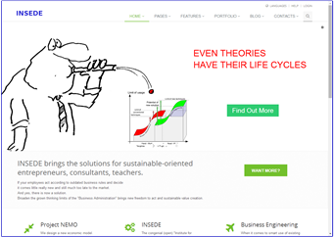

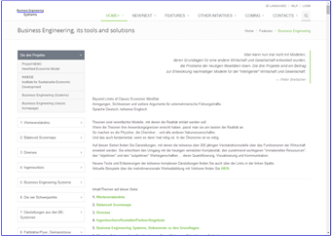

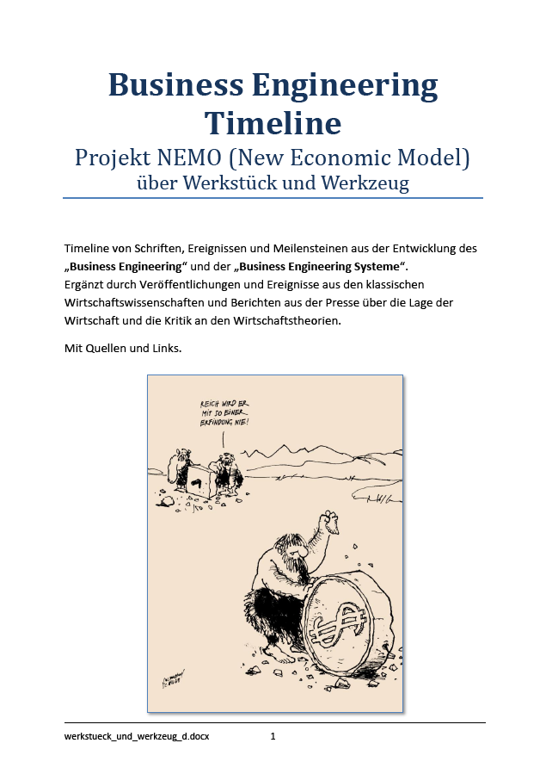

Further WEB-Links
Three smart steps for clever real world solutions.
Project Nemo
(New/Next Economic Model)
http://project-nemo.org
Project NEMO
The project that realizes the «New/Next Economic Model»
Project NEMO The project that realizes the «New/Next Economic Model»
INSEDE
Clever solutions for the smart real world
INSEDE (Institute for Sustainable Economic Development)
https://insede.org
Business Engineering Systems
Modular, new options beyond old systemic traps
Business Engineering Systems
(Tools for decisions in a smart economy)
https://bengin.net/bes/
Business Engineering Timeline
(History of development incl. links to further sites and papers)
https://bengin.net/permalink/werkstueck_und_werkzeug_d.pdf

