Slide 1
INSEDE
Increase performance
through measuring, mapping and managing values.
New 2015 - this content is now part of:
Project NEMO (New/Next Economic Model) http://project-nemo.org
INSEDE (Institute for Sustainable Economic Development) https://insede.org
Business Engineering Systems (MindWare, Basics, Structures) https://bengin.net/bes/
You are welcome to take advantage of progress, support us and be part of this voyage of discoveries.
bengin_new_dim03_e

Slide 2
You can manage what you can't measure.
(No one can administrate what's not measurable.)
May be your employees can't just yet.
That's one of the reasons why you should introduce measures for the unmeasurable.
Peter Bretscher
Andreas Bürgi
23. August 2003

Slide 3
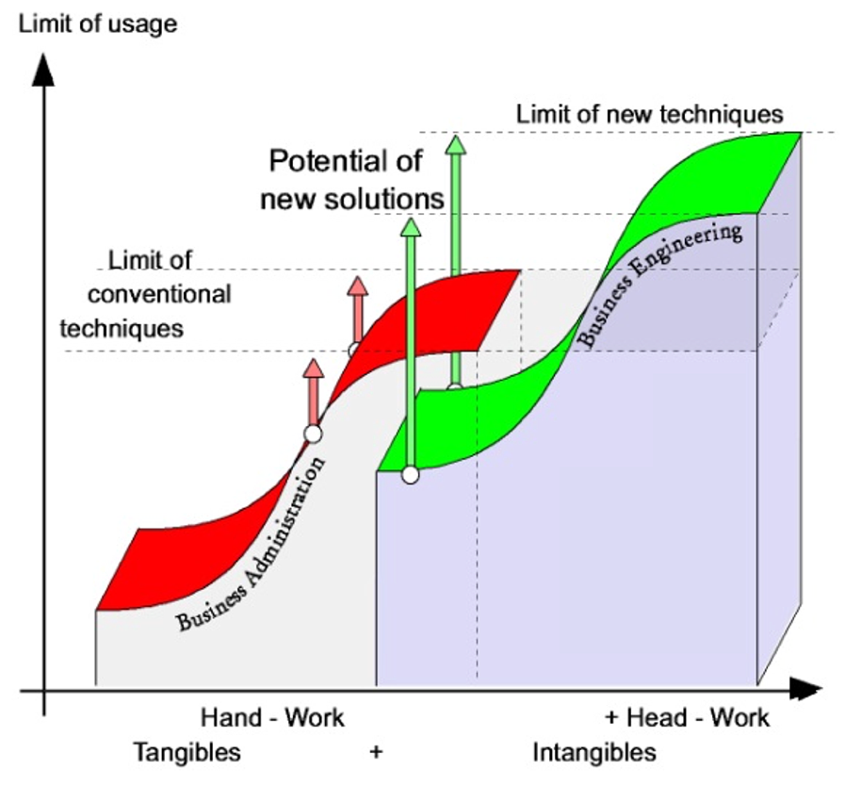
Next step, focus on economic MindSetting / Paradigms

Slide 4
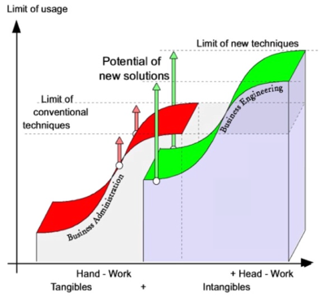
New MindWare & SoftWare → quantum leap in the simulation and planning of today's economy.
Solutions
(Form & Content)
Applications
Applications
SoftWare
MindWare
Operating System
Economic Theory
Basics
Hardware
Real economy

Slide 5
Reality of business has changed – models have to follow
Identity &
Strategy
Innovation-
Information-
management
management
Resource-
bengin
Value/Perf.-
Management
management
Solutions
©
Finance
Intangibles
Risk
Options
a)
structuring
b)
quantifying
. . . . . . . new maps
“iCap.” Economy . . .

Slide 6
Agenda
1.
2.
3.
Structuring
the elements
of an
enterprise.
Quantifying means.
And now?

Slide 7
Structuring the elements of an enterprise
1. Offerings
2. Processes
3. Resources

Slide 8
Structuring the elements of an enterprise
Solutions for customers
1. Offerings
Products
Services
Rights

Slide 9
Structuring the elements of an enterprise
Managing the enterprise
2. Processes
Creating
Products
Creating
Services
Creating
Rights
Maintaining Resources

Slide 10
Structuring the elements of an enterprise
Primary Resources
Products
Betriebsmittel
Documents
Know-How
Rights
Finance
3. Resources
Information
.....
Secondary Resources
.....

Slide 11
The enterprise model
Offerings: ● Products
● Services
● Rights
Processes: ● Management
● Creating solutions
(Products, Services, Rights)
● Maintaining, developing
resources
Pre-Requisites: ● Resources
● Resorts (Marketing, R&D, Prod., QS, HR..)
● Customer/Dispatch
● Supplier
● R&D - projects
● ...........

Slide 12
What for?
Classic
Outside-in
Customer
Complementary
Strategy
+ Inside-out
Knowing and using assets in a more holistic and effective manner.

Slide 13
Loop-relations of enterprises

Slide 14
What for?
Optimizing flow of:
Offerings
Processes
Resources
(tangible and intangible)
Money
other types of business objects
Increasing / reducing / redirecting the flow on the map.
Leads to new options for doing business.

Slide 15
Applications
1.
2.
3.
Structuring
the elements
of an
enterprise.
Quantifying means.
And now?

Slide 16
Quantifying means
Types of objects:
Tangible objects.
Intangible objects.
Types of metrics:
Subjective metrics
References to subjective impressions.
Relative metrics
References to a nonagreed numerical base.
Absolute metrics
Relation to an agreed numerical standard.
Absolute metrics are metrics with an agreed/normed standard from a Standardization Organization.
Before they became "agreed absolute metrics" they were nonagreed relative metrics.

Slide 17
Quantifying means
If you want to count and map multidimensional attributes
(such as the value) of an object,
you have to use a multidimensional metric system which shows and visualizes the chosen attributes in an understandable context.
Just compiling a lot of linear, unrelated metrics does not help.

Slide 18
Quantifying means
Content of information. The cube as an object.
a x b x c = d
Reduction of measures to linear metric "d" reduces the content of information significantly.
Reduction of value-measures to a linear monetary metric system limits the usage of this system for mapping reality.

Slide 19
Quantifying means
The work of physicists:
Look at (some problems of) the real world.
Invent a numerical solution to explain (some problems of) the real world.
- either by using the paradigms of classic physicists, or by
- expanding classic paradigms ..... (Heisenberg, Einstein....),
- inventing new numbers, metrics .... (Gauss, Curie...),
- enabling unexpected additional inventions.
Test, verify, correct solution, implement restrictions and patches.
Measuring multidimensional attributes with a linear and singular ruler leads to a mental dead end.

Slide 20
Objects, Attributes, Value-Measures
Resources
Objects
Explicit Values
Numbers
tangible
intangible
Real
Numbers
Unit:
Objective Numbers
CHF, $, €
Imaginary Numbers
Unit:
Subjective Numbers
Implicit Values
iCHF, i$, i€
Complex Numbers
Unit:
Vector
CHF/iCHF, $/i$, €/i€
combined

Slide 21
Development of Metrics
Why Metrics?
Making rational (and indirect) communication easier.
% .. i$
3. Quantitative
Metrics
reducing need
for interpretation
(multi dimensional)
$
2. Qualitative
Metrics
(linear)
$
Hot, cold ...... AAA, A+, B, C
strong need for interpretation
1. Normative "Metrics"
Principles, ....the xx "commandments"
Time

Slide 22
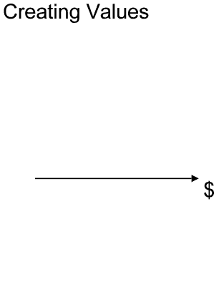
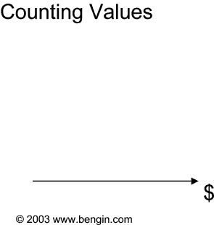
Measuring performance
http://www.performanceprofile.com
http://www.balancedscoremap.com

Slide 23
Next steps
1.
2.
3.
Structuring
the elements
of an
enterprise.
Quantifying means.
And now?

Slide 24
5 steps to increase the performance
1. (re)cognise your assets
2. perform the (2D)valuation
3. draw/show the valueprofile
4a. set the targets and priorities
4b. Repeat steps 1. to 4.
as often as necessary
5. Launch projects

Slide 25
insede – the value architects and engineers
We build individual value systems.
We build individual value enabling systems.
This document is a component of the business engineering system
(Registered copyright TXu 512 154, 20. March 1992).
We own the complete intellectual propriety to the systems and parts of it. Commercial use, teaching and publications require one of a license.
An unlawful use is a punishable offence in the commercial area.
Ask your consultant (or us) for his individual license number.

Slide 26
INSEDE (in founding stage)
INSEDE
- the legal entity for the practice oriented further development and distribution of economic knowledge, views and perspectives. It was founded by businessmen, convinced that in classic economic theory, among other things, the intangible objects were neglected in a distorting manner.
One of the tasks is not only to show this kind of lack, but to develop instruments with which some weaknesses of the classic business economic paradigms are weeded out quite pragmatically.
A quickly growing community supports INSEDE in the development, distribution and application of the new generation of economic models.
Contact for inquiries:
Ingenieurbüro für Wirtschaftsentwicklung
Peter Bretscher, Alpsteinstrasse 4, CH-9034 Eggersriet, Switzerland
Mobile: +41 79 650 49 04 Email: peter.bretscher@bengin.com
We look forward hearing from you.

Slide 27
«We have to introduce a quantitative logic for
values, wherein the whole kind of business
resources and valuation perspectives will be
taken into consideration.»
Aurelius von Damos
We care about that – and more.
bengin

Slide 28
Thank you
insede.org
(Re)cognising Values, developing, using

Slide 29
Economic Value Architecture & Engineering
Intangible
Economy
Classic
Economy
mV [$]
Stock exchange
Next Economy
M
(explicit)
Balance
Intro
iV for
implicit Value
I
(implicit)
Balance
Time
iV [i$]
M
(explicit)
In & out
REV(Real Enterprise Value)
SPE(Shareholders Profit Expectation)
I
(implicit)
In & out
iV
mV [$]
Structure^{*)}
REV + SPE = TEV
TEV = Total Enterprise Value = “Shareholder Value”
mV
Value Track
^{*)} Structure as proposed by:
Balanced Scorecard and other existing solutions for structuring (intangible) assets.
We recommend BE-Systems.
iV [i$]
(Ortskurve, TEV)
I_{c}-Function
mV [$]

Slide 30
The four Quadrants of Value generation
+I
in
Q I: Transform -M / +I
- New projects
- Revisions of offerings
- Insourcing/merging
-
Q I
Q II
R&D
Transformation
(M to I)
Value
Generation
Q II:Generation +M / +I
- Daily business
- Selling, dispatch
- (Re)Production
-
-M
+M
out
in
Q III: Transform -I / +M
- Outsourcing
- Leaner production
-
Value
Degeneration
Transformation
(I to M)
Q IV
Q III
Q IV:Degeneration -I / -M
- Graveyard
-
out
-I

Slide 31
Intagible Assets or Shareholder Value Expectation?
Intangible
Value
[i - Mia]
80
Coca
-
Cola
75
70
The explicit value and the implicit value together draw a complete picture of the company’s value and its development.
The question remains:
Is the implicit value given by the value of the company?
Is it attributed by some marketing tricks?
Which part of it is created under the influence of the Shareholders Value Expectation?
65
60
55
50
Microsoft
IBM
45
40
35
30
McDonald's
25
Ford
20
15
10
5
5
10
15
20
25
30
35
40
45
50
55
60
65
70
75
80
Tangible
Value
[Mia]

Slide 32
A better model for new decisions
Value points of 75 enterprises
10'000
9'000
Investors: Attention!
8'000
7'000
6'000
implicit values
5'000
4'000
3'000
2'000
Management could use
potential more effectively
1'000
0
0
1'000
2'000
3'000
4'000
5'000
6'00
0
7'000
8'000
9'000
10'000
explicit values

Slide 33
Track the development of an enterprise
Pointer of vector for five years
1'400
Question:
"What happened in the year 1996?“
Answer:
Part of the enterprise was sold.
2nd Question:
Is this loss of intangible values compen-sated by the price received for the sold
part of enterprise.
Answer: ?
→ Ask the Auditor – if he’s still available….
1'200
92
95
1'000
93
94
800
96
intangible axis [ Mio iCHF]
600
400
200
0
0
200
400
600
800
1'000
1'200
1'400
1'600
material axis [Mio CHF]

Slide 34
Value Development (Shareholders view)
iV
3000 Mio
Enterprise Value
2500
2'520
2000
1969
SPE
Initial Base (Value estimation)
1500
Initial Offer, March 24. 2000
SPE
Shareholders Profit Expectation
Evening 1st Day
1000
648
500
551
97
97
0
0
0
mV
0
10
20
30 Mio

Slide 35
Overpriced Papers?
....one year before the classic Market Analysis,
the Vector map showed a change in Coca Cola Amatil.........
Stock Exchange Value
Value Vector
12000000000
9000000000
97
1990
10000000000
97
8000000000
1991
7000000000
96
8000000000
96
1992
6000000000
1993
6000000000
98
5000000000
1994
99
4000000000
98
1995
4000000000
Implicit Values
1996
3000000000
2000000000
2000000000
1997
0
1000000000
1998
1990
1991
1992
1993
1994
1995
1996
1997
1998
1999
0
99
1999
0
2E+0
4E+0
6E+0
9
9
9
Explicit Values

Slide 36
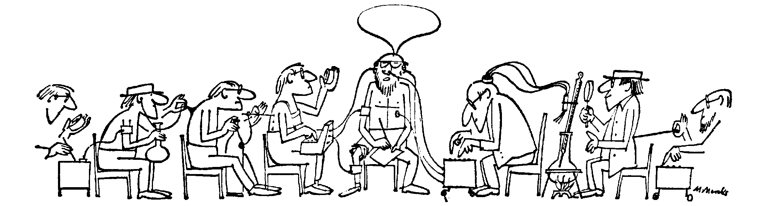
Explained world
Value
Nach: Marle Marks,
Manager Magazin 3/85

