Slide 1
Thoughts for a complementary view to the Classic Economic Mindset
Peter Bretscher © 2012
https://bengin.com/
https://insede.org/

Slide 2
Documents are part of «Business Engineering Systems», registered Copyright TXu 512 154
Consulting license No. CG01120612 (for enduser).
(Attendees ickc June 12, 2012)
Updates and further information see:
http://bengin.net/12/ickc_e.htm

Slide 3
Agenda
Peter Bretscher
Practical need for model that integrates intangibles
Findings & Project
3 Levels of Enterprise
Values, Visuals & Framework beyond Smith & Co
Links

Slide 4
Peter Bretscher,
Practical need for model that integrates intangibles

Slide 5
Professional Mechanician (Handwork)
Professional Engineer (Mindwork)
(R&D, Production, Marketing, IP-Rights, transdisciplinary trouble-shooting, special tasks....)
∆ between real live and (business) theory
Technology & Knowhow Transfer
- no books, no theory, no best practise....
- need for inventing a model realize T’Transfer
(one that includes knowledge and other intangibles)

Slide 6
Obstacles – why?
World 1
World 2
World 3
real
reality
experienced
reality
explained
reality

Slide 7
Findings & Project

Slide 8
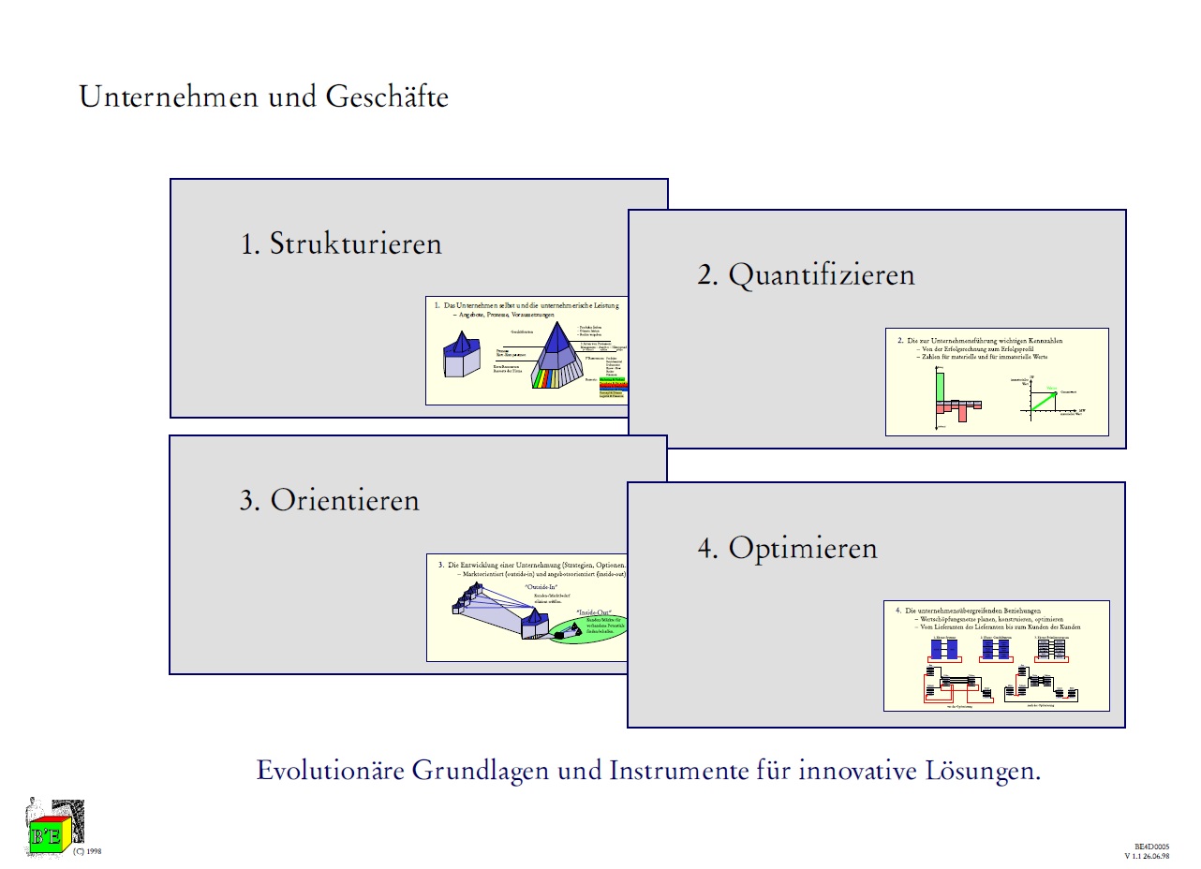
1. Bottom up structuring reality,
3D-Models
2. Metrics that enables quantifying subjective dimension of value

Slide 10
Economic theory is a product, a tool that no longer fits the needs.
Task
Develop a new theory from bottom up that includes (tangible and intangible assets) and that makes subjective valuation quantifyable.
Huge preliminary work
3D Models, 300 GB
Registered Copyright
INSEDE
(open) Institute for Sustainable Economic Development

Slide 11
3 levels of enterprise

Slide 12
Primary-Resources

Slide 13
Values, Visuals & Framework beyond Smith & Co
Vector Type 1

Slide 18
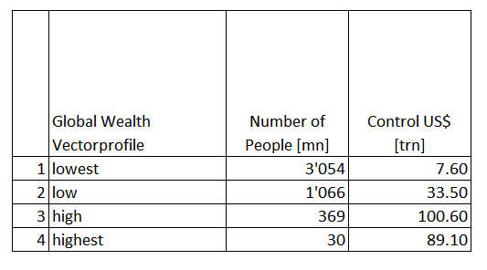
4 cluster
X – axis
Y – axis

Slide 19
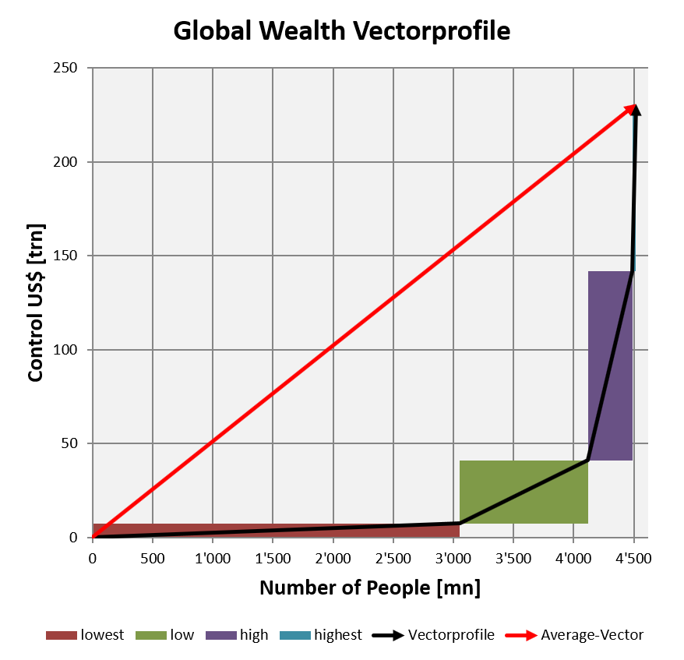
Vector Type 1
http://bengin.net/beta/04_global_wealth_vector_cs_e.xlsx

Slide 20
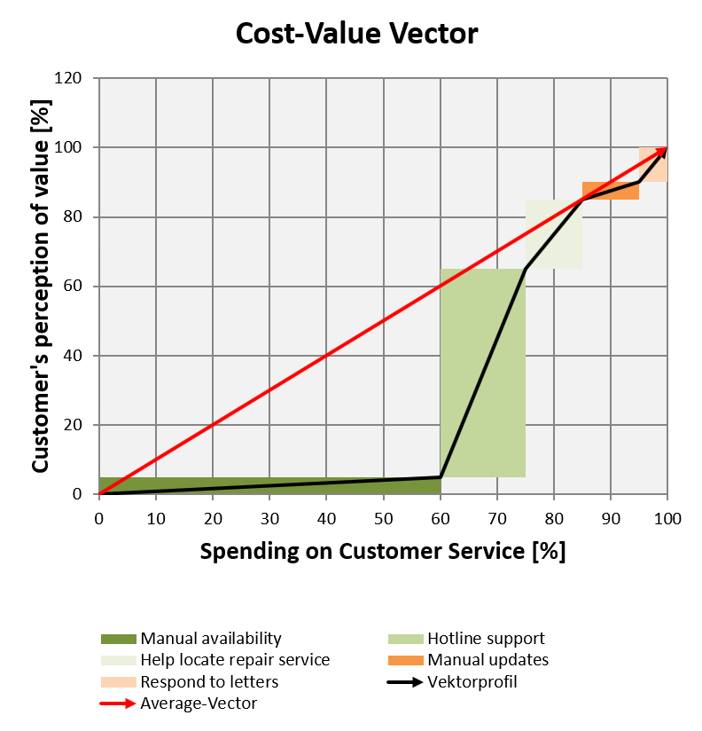
Vector Type 1

Slide 21
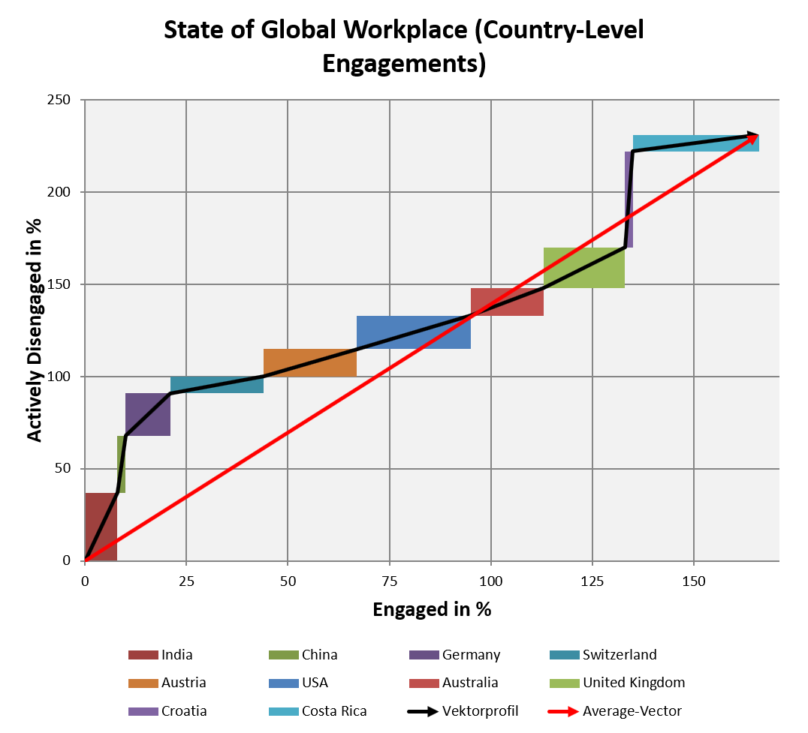
Vector Type 1
http://bengin.net/beta/10_global_workplace_gallup_2011_e.xlsx

Slide 22
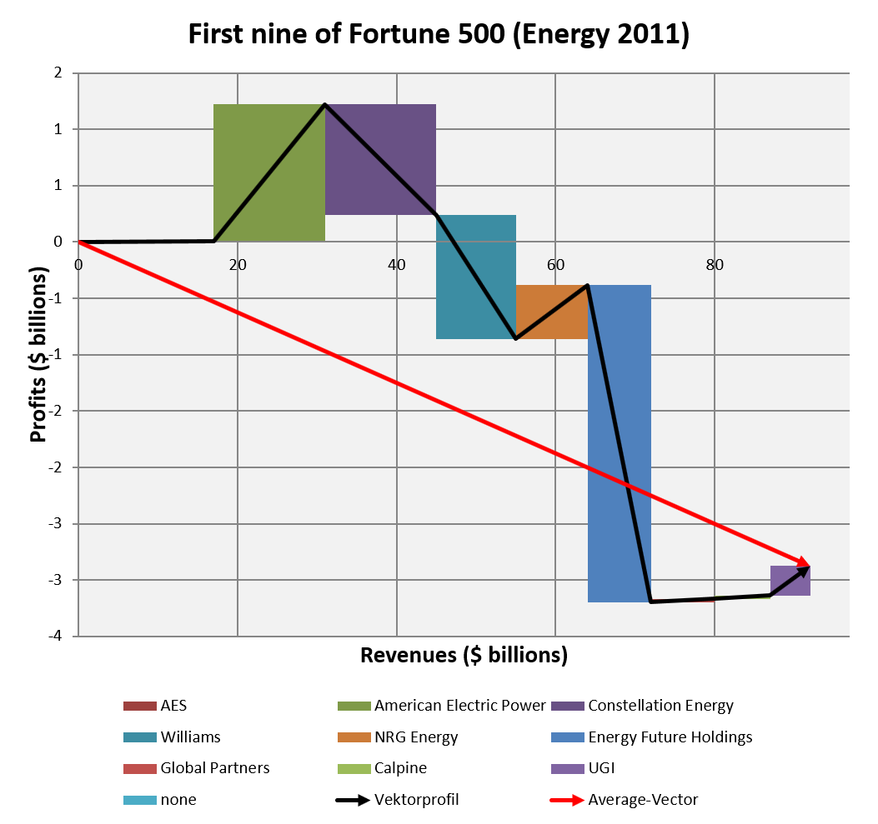
Vector Type 1
http://bengin.net/beta/10_fortune500_energy_rect_e.xlsx

Slide 23
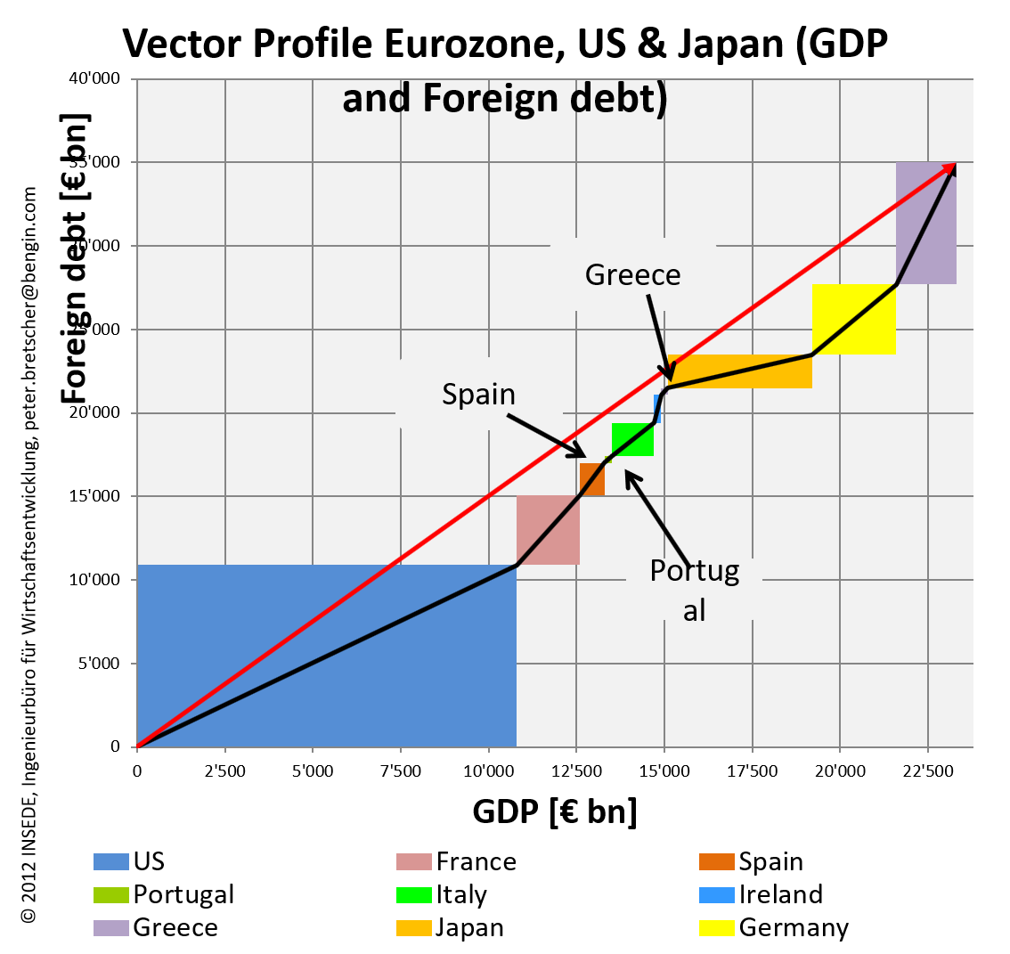
Vector Type 1

Slide 24
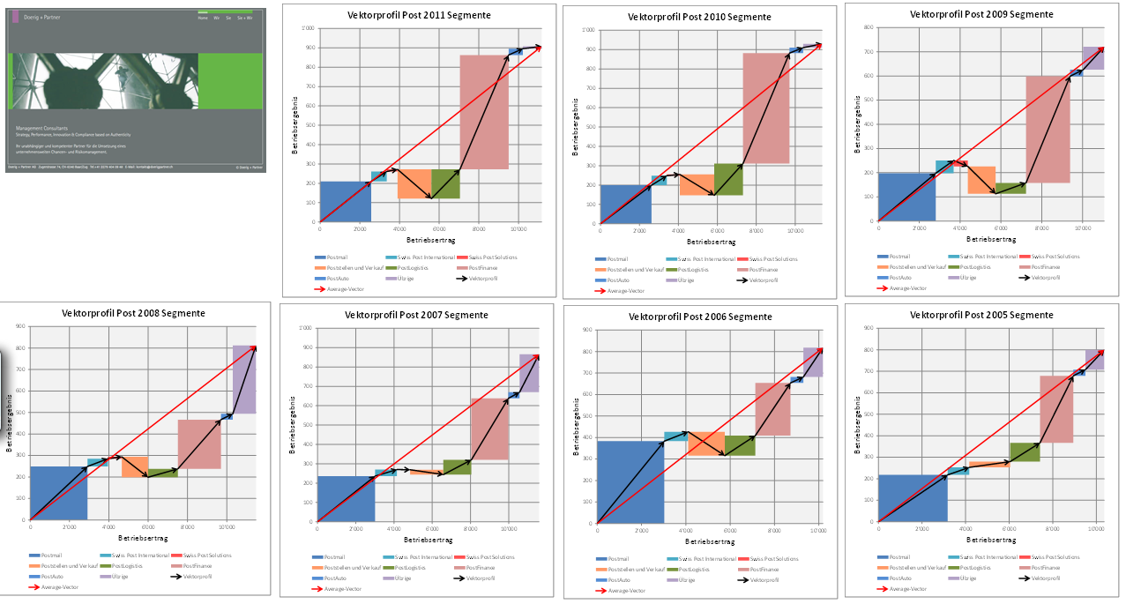

Slide 25
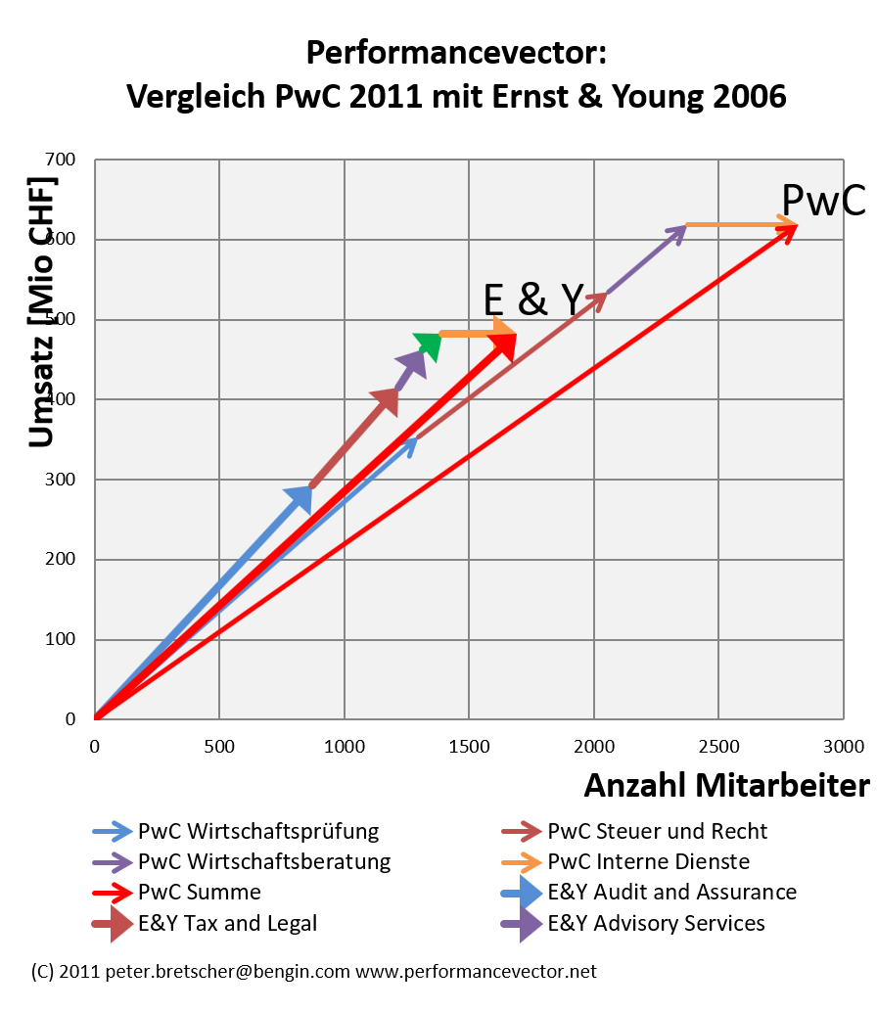
Vector Type 1
http://bengin.net/beta/pwc_ey_2_performancevector_d.xlsx

Slide 26
Values, Visuals & Framework beyond Smith & Co
Vector Type 2

Slide 37
What to make with potential

Slide 43
Further links

Slide 44
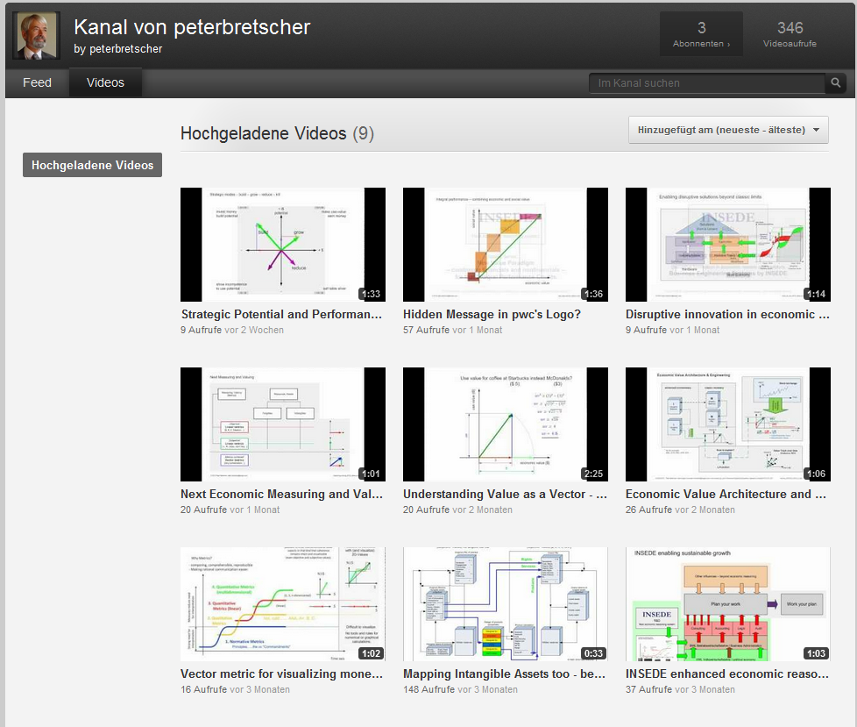
http://www.youtube.com/peterbretscher

Slide 45
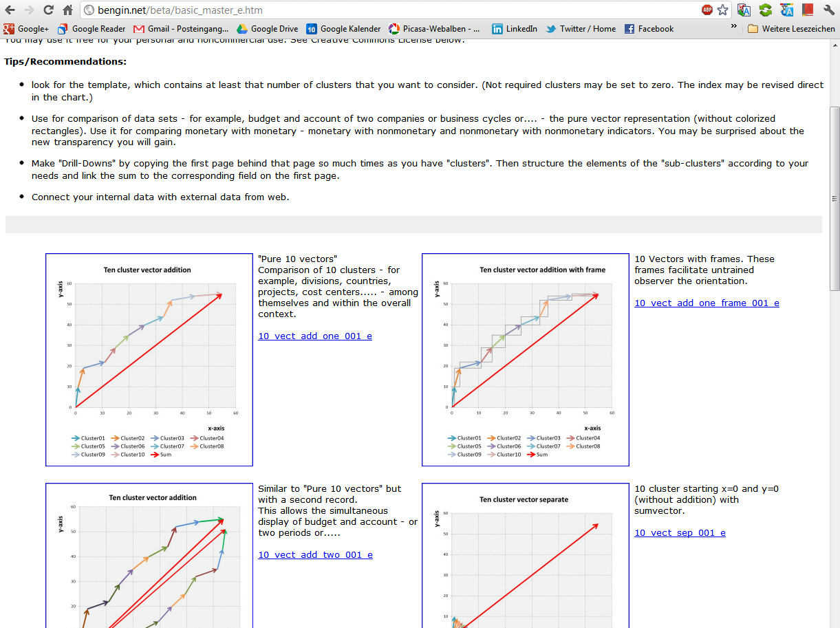
http://bengin.net/beta/basic_master_e.htm

Slide 46
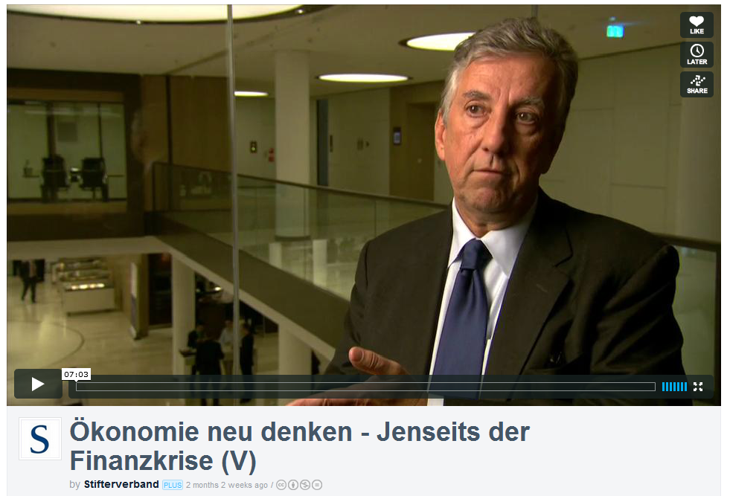
Ineteconomics.org Rob Johnson
English spoken
http://vimeo.com/38091481

Slide 47
Questions?
Thank You

Slide 48
Other slides

Slide 61
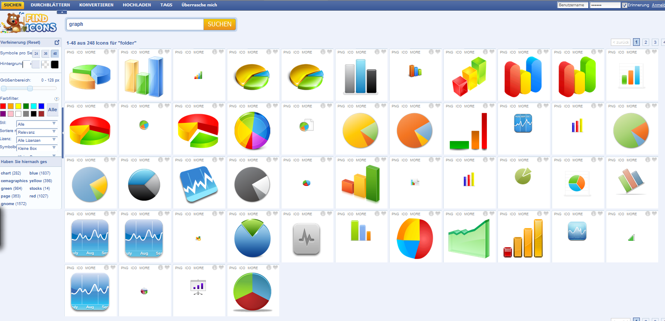
www.findicons.com

