Slide 1
bengin

Slide 2
Expanding value paradigm (in a hurry)
Peter Bretscher
6. November 2002

Slide 3
Agenda
1.
2.
3.
Objects
Measures
Values
Maps
Relative and absolute Value maps
Applications
Outlook

Slide 4
Objects – Measures – Values – Maps
Object
Measures
Black
Box
Key Figures
Nature: → tangible, intangible
1. Absolute [€, $, CHF]
2. Absolute [€, $, CHF]
3. ......
n relative
Metrics
1 D
2 D
3 D
….. n D
Force & Direction
Coordinates
Color Theory
Coordinates: RGB

Slide 5
Relative and absolute Value maps
a) relative Vector, Vector profile
b) absolute Vector, Ortskurve
%
iV
V₁
V₄
V₃
Structure
Value Track
iV [i$]
V₃
mV
V₄
V₂
cost
V₂
price
V₁
$
mV [$]
c) Shareholders Valuation
d) Value Quadrants
+ I
iV [i$]
R&D
Q I
Transfor-mation (M to I)
Q II
Value
Generation
REV(Real Enterprise Value)
SPE(Shareholders Profit Expectation)
- M
Q IV
Value Degenera-tion
Q III
Transfor-mation (I to M)
+ M
mV [$]
REV + SPE = TEV
TEV = Total Enterprise Value = “Shareholder Value”
- I

Slide 6
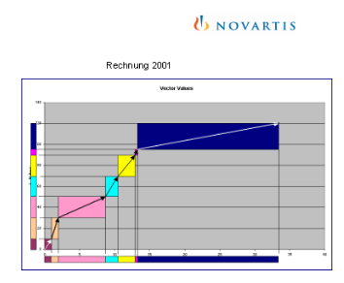
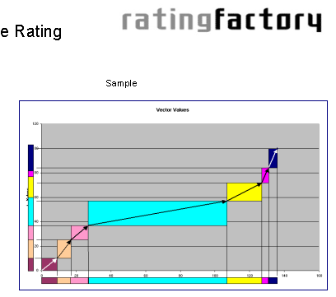
Applications, Outlook
Stock Exchange Value
Value Vector
96
97
97
Implicit Values
96
98
98
Value points of 75 enterprises
99
99
Explicit Values
1990
1991
1992
1993
1994
1995
1996
1997
1998
1999
implicit Values
explicit Values
Where to be used
For complex valuation and controlling purposes. Better valuations. Corporate governance, Project controlling, Benchmarks, M&A, Nonfinancial audit.....
Outlook
Focus more on techniques (as a product) than on technology.
Standards for mapping tangible and intangible resources: a) structuring means b) quantifying means.
The intellectual property.

