Slide 1
Reporting and Communications
Developments
Juergen H. Daum
SAP AG

Slide 2
Today’s Corporate Reporting Challenges
The purpose:
To solve investor‘s/stakeholder‘s information problem:
„ How good or bad will the black box perform?“
Today
The Company
Tomorrow
Input
(Investment)
Output
(Return)
1. The Knowledge Economy: Changing Internal Business Economics
Traditional Industrial
Operations Model
Today’s Operations Model
Product
Developm.³
Procure-
ment
Manu-
facturing
Sales
Fullfillment¹
CRM ²
Distribution
Suppliers
Customers
Physical Assets
Ph. Assets
HR
Alliances
IS
Time dimension: Month/Quarter
More direct relation between input and output
Resources/Assets can be acquired and deployed
short term
Reporting and control instruments: I/S, B/S
Time dimension: Quarter¹, 1-2 years², 3-5 years³
More indirect relation between input and output
Major resources have to be developed in-house
Reporting and control instruments:
?
Reporting on capabilities and resources
(assets):
Balance Sheet
Reporting on value
extraction success
(profit):
Income Statement
- Dynamic Complexity: Growing tension between value creation / value extraction
- Assets and operations more interlinked

Slide 3
Today’s Corporate Reporting Challenges
2. The Networked Economy: Changing Enterprise Structures
global
integrated
enterprise
global
integrated
ecosystem
of partners
Employees
Investors
Society
Active
Punish under-
performers
New perception
of corporate responsibility
New influence groups (NGOs)
3. The Democratized Economy: Changing Corporate Governance
Standards
Mobile
Scarcity of talent
Enterprise Inc.
Customers
Partners
Less loyal
Active
Engage stakeholders into the value creation process of the firm
Stakeholder relations become „assets“
No company is able to
work without partners
anymore
Requirements:
  Extended information about corporate performance: The corporate reporting system has to reflect the companies business model and should inform about operational KPIs as well as about strategy,
  its implementation process, and about related management challenges
  Information about the dynamics of long term value creation and short term performance management: Transparency of risks and opportunities. Information about how the company is trying to balance short performance vs. long term value creation.
  Information about the extended enterprise: Status of network creation activities, information about the network’s potential and about its performance
  Stakeholder oriented reporting and communication: Engange stakeholders into the corporate strategy and performance management process. Reporting from a stakeholder point of view.

Slide 4
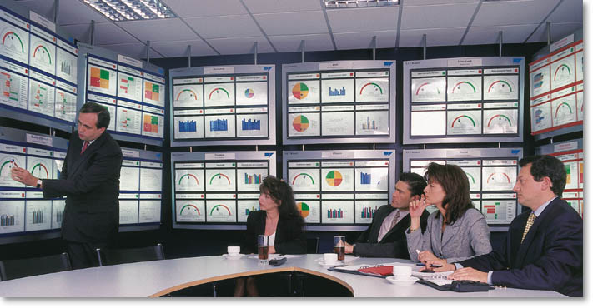
Corporate Reporting and Communication Developments
Examples of current work for improving corporate reporting
FASB / SEC
Framework for Supplemental Reporting: business model description, intangibles
performance measures, operational performance measures, opportunities and risks (forward looking)
Baruch Lev
Enhanced GAAP + Value Chain Blueprint: capitilization of intangible investments,
intangible value creation process KPIs, „knowledge capital“/ book value vs. „comprehensive value“
Danish Governm.
/ Skandia
Intellectual Capital Statement:
„knowledge narrative“, management challenges, IC indicators (e.g. Skandia‘s Navigator)
Global Reporting
Initiative
Sustainability Reporting / Triple Bottom Line Reporting:
Economic Performance, Environemental Performance, Social Performance
Common principles: Voluntary reporting, in addition to GAAP-based financial reports,
no direct valuation of intangibles / focus on value creation process, stakeholder orientation
A possible framework for corporate reporting and communication
„Content“
„Procedures“
Background Info
KPIs / Measures
Stakeholder
Dialog
Communication
to the public
„Theory of Business“
Strategy
Business Model
Management challenges and
opportunities & risks
Stories / examples
Strategy Implementation
/ Total Performance
Ilustrated printed
annual reports
Ongoing reporting
on the corporate website
Others „Mise en Scène“
of a company‘s essence
(e.g. Swiss Re
Rüschlikon...)
Product innovation
Stakeholder
Engagement
Process
Operations:
CRM + Fulfillment
Internal Management
Process
Resource management (HR, Fin.,Alliances,IT)
„Tableau de Bord“

Slide 5
Sources
FASB Business Reporting Research Project: Improving Business Reporting, Jan 2001
http://www.fasb.org/brrp/BRRP2.pdf
SEC-Inspired Task Force: Strengthening Finanical Markets, May 2001
http://www.fei.org/download/SEC-Taskforce-Final-6-6-2k1.pdf
Baruch Lev: Intangibles – Management, Measurement, and Reporting, June 2001
http://www.baruch-lev.com
http://www.juergendaum.com/news/10_30_2001.htm
Danish Agency for Trade and Industry: A Guideline for Intellectual Capital Statements, Nov 2000
http://www.efs.dk/download/pdf/videnUK.pdf
Global Reporting Initiative: Sustainability Reporting Guidelines 2002, Sept 2002
http://www.globalreporting.org/GRIGuidelines/2002/gri_2002_guidelines.pdf
Juergen H. Daum: Intangible Assets and Value Creation, Dec 2002 (English), May 2002 (German)
http://www.juergendaum.com/mybook.htm
Juergen Daum‘s Website on Enterprise Management, Leadership and Business Control
http://www.juergendaum.com
especially the following reports are dealing with corporate reporting:
http://www.juergendaum.com/news/09_22_2002.htm
http://www.juergendaum.com/news/05_12_2001.htm

